Slide 1

Azure Cloud Commanders Azure OpenAI & GitHub Copilot

Slide 2




So, who am I?
My name is Luke Murray
He/Him
Senior Consultant at Datacom in Hamilton, New Zealand.
Feel free to reach out on Social Media, if you need any help: https://linktr.ee/lukemurray
Introduction
Azure Cloud
Commanders

Slide 3
Today, we are going to look into tools that we use every day, and touch on Azure Open AI and GitHub Copilot!
Agenda

Slide 4
Leave questions till the end.
Feel free to reach out on Social media

Slide 5







Microsoft AI timeline
Jun 2022
GitHub Copilot generally available
Oct 2022
Microsoft Designer product launch
Jan 2023
AOAI service generally available
Jan 2023
Microsoft extends partnership with OpenAI
Feb 2023
New Bing and Edge powered by GPT4
March 2023
ChatGPT and GPT4 in AOAI service
March 2023
Microsoft 365 Copilot,
Github introduces Copilot X
image generated by DALLE2

Slide 6







Teams
Business
Microsoft and OpenAI partnership
Platforms
Microsoft & Open AI Partnership
Ensure that artificial general intelligence (AGI) benefits humanity
Empower every person and organization on the planet to achieve more
Operations
GPT-3.5
ChatGPT and GPT-4
Codex
DALL·E 2
Text
Conversation
Apps &
Data
Code
Images

Slide 7
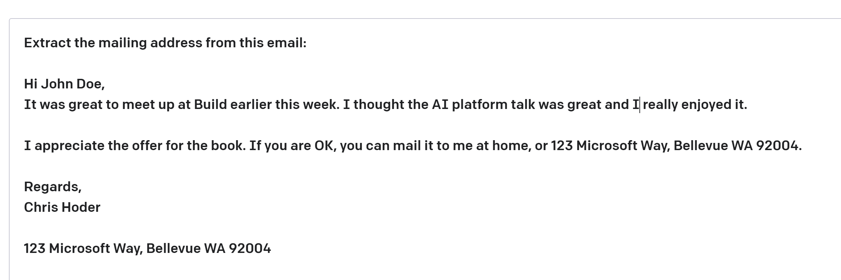
| OpenAI Key Terms
OpenAI Terms
some context
Prompt—Text input that provides some context to the engine on what is expecting.
Completion—Output that GPT-3 generates based on the prompt.
Token — partial or full words processed and produced by the GPT models
https://learn.microsoft.com/en-us/legal/cognitive-services/openai/transparency-note

Slide 8












Prompt
Answers
Question
Transformer Model
Reasoning
Context Analysis
Chat
Tokenizer
Tokenizer
Microsoft & Open AI Partnership
Information Extraction
Zero shot
Few shot
Attention
Weightings
Vector
Object Recognition
Follow Instruction

Slide 9
Large, pretrained Language Models that use deep learning to produce text outputs
GPT-3.5 ChatGPT (preview) GPT-4 (preview)
GPT
Custom-tunable AI models with your data
Built-in responsible AI to detect and mitigate harmful use

Slide 10
Comparison of GPT versions
GPT-3.5
ChatGPT (preview)
GPT-4 (preview)
GPT - COmparisons
Most economical GPT model in Azure OpenAI Service
Available in Western Europe
Use-case specific models to optimize inference time and performance
Suitable for a large range of use cases
Should be first choice for most use cases
For all workloads, not just Chat
Improved problem solving and reasoning capabilities
Iterative refinement:
Paste in code errors & GPT-4 will fix for you
Iterate on stories
Increased token limit - works well for long content

Slide 11








Document Process Automation
Extract rich insights from documents and summarize https://azureaidevs.github.io/hub/2023-aia/day10
Cosmos DB
PDF OCR pipeline
Open AI – Use Case
Web Application
Documents
Azure Form Recognizer
Azure Cognitive Search
Power BI
Azure OpenAI Service

Slide 12
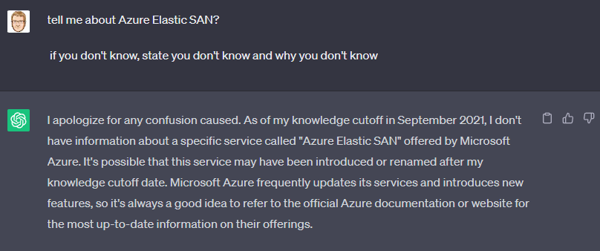
Azure Open AI
- Azure Docs
https://luke.geek.nz/azure/Bring-Your-Data-to-Life-with-Azure-OpenAI/

Slide 13

KEEP
CALM
AND
DEMO IT IN AZURE
Azure Open AI
- Azure Docs

Slide 14
Next up, Codespaces and GitHub Copilot Chat
Github Codespaces
Spin up fully configured dev environments in the cloud that start in seconds with up to 60 hours a month free.
Get started for free Plans and pricing

Slide 15

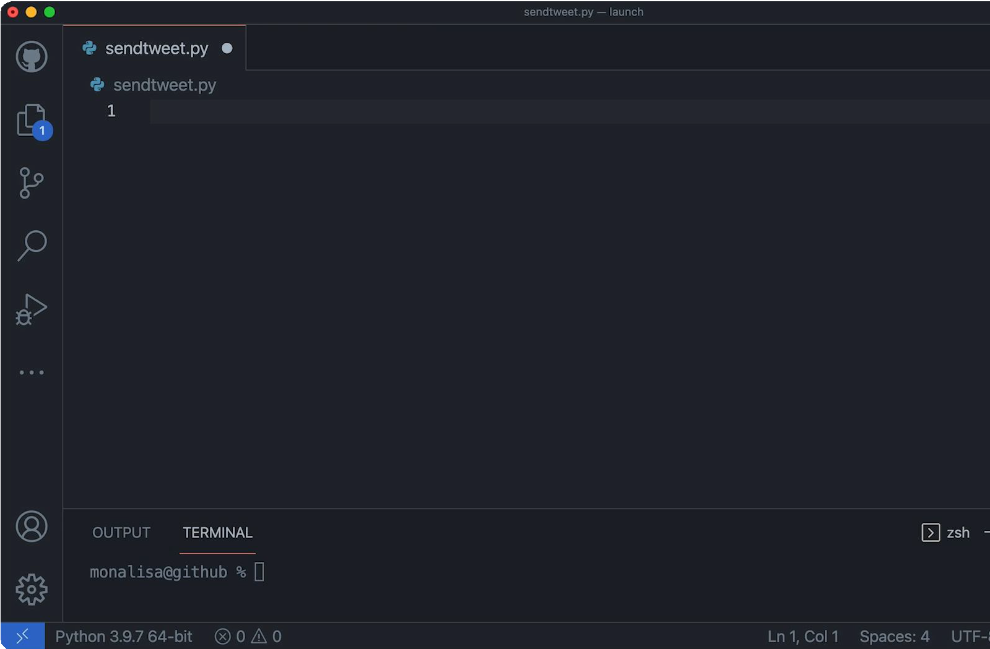
GitHub Copilot
Github Copilot
Your AI Pair Programmer

Slide 16
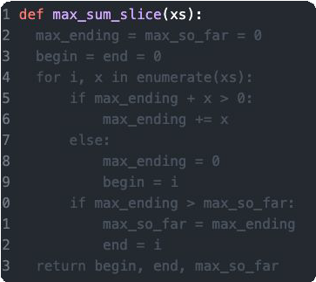
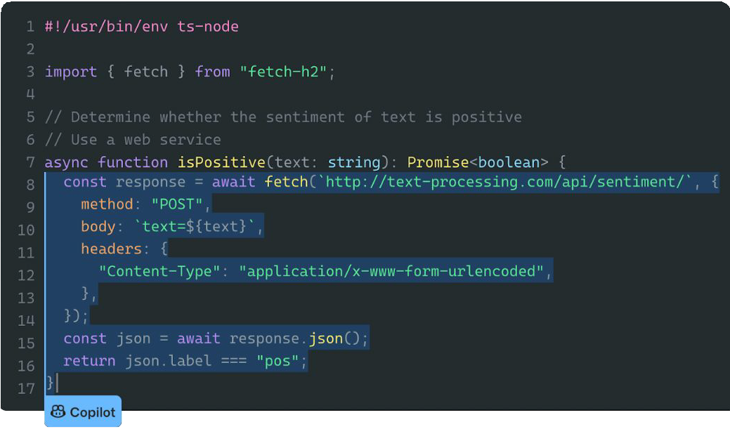
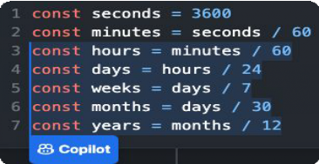
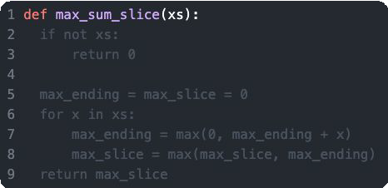
The main features
Convert comments to code
Show alternatives
Autofill repetitive code
Github Copilot

Slide 17
KEEP
CALM
AND
DEMO IT IN AZURE
Codespaces and GitHub Chat

Slide 18

Do not humanize AI!
Generative AI
is not:
Intelligent
Deterministic
Trustworthy
Do not humanize AI
Always ensure to use AI output responsibly.
Image created by DALL E2
aka.ms/responsibleaiprinciples

Slide 19
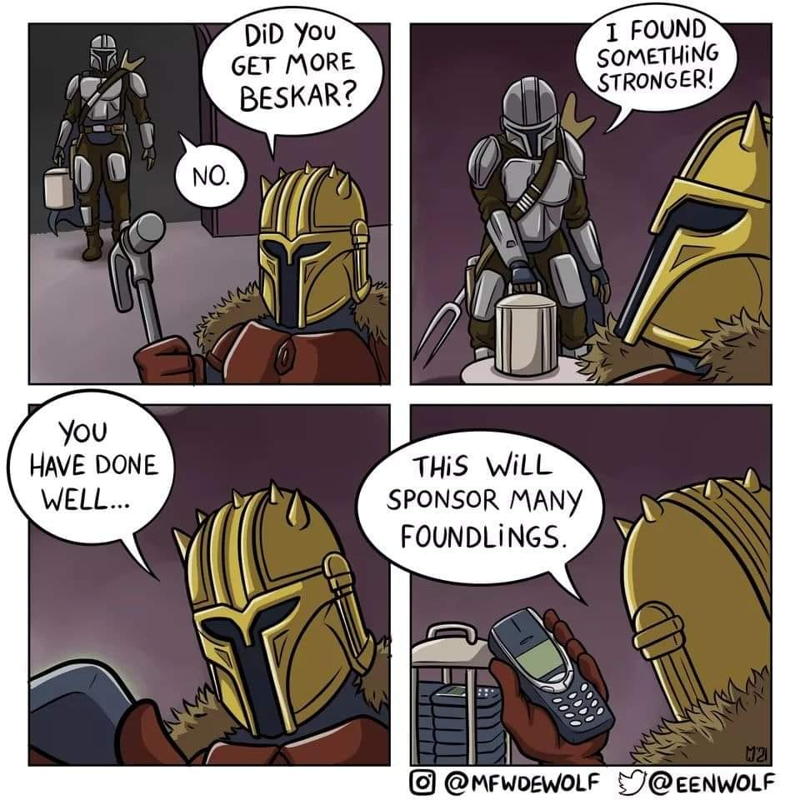
THANK YOU!

Slide 20
Azure OpenAI Service Learning Guide
Create an Azure subscription
Apply for access to the Azure OpenAI Service: https://aka.ms/oai/access )
Watch the video: An Introduction to Azure OpenAI
Get Familiarized with the product content: Azure OpenAI Page
Review how other customers are using Azure AI
How-to guides: Generate embeddings and Fine-tune
Complete embeddings and document search tutorial.
How your/your customer data is processed, used and stored in Azure OpenAI: Data, privacy and security
Review the Enterprise Data with ChatGPT tech blog, and work through the accompanying GitHub repository.
Become familiar with the APIs
Basic
Advanced
Start Here!
Intermediate
Learn more in the Azure OpenAI WorkshopI
See examples in the Open AI Cookbook
Start experimenting and developing your MVP
Get support and help
Understand “What is Azure OpenAI?”: compare Azure OpenAI and OpenAI. Review key concepts.
Work through Introduction to Azure OpenAI Service training module
Explore key Responsible AI guidelines and principles

Slide 21
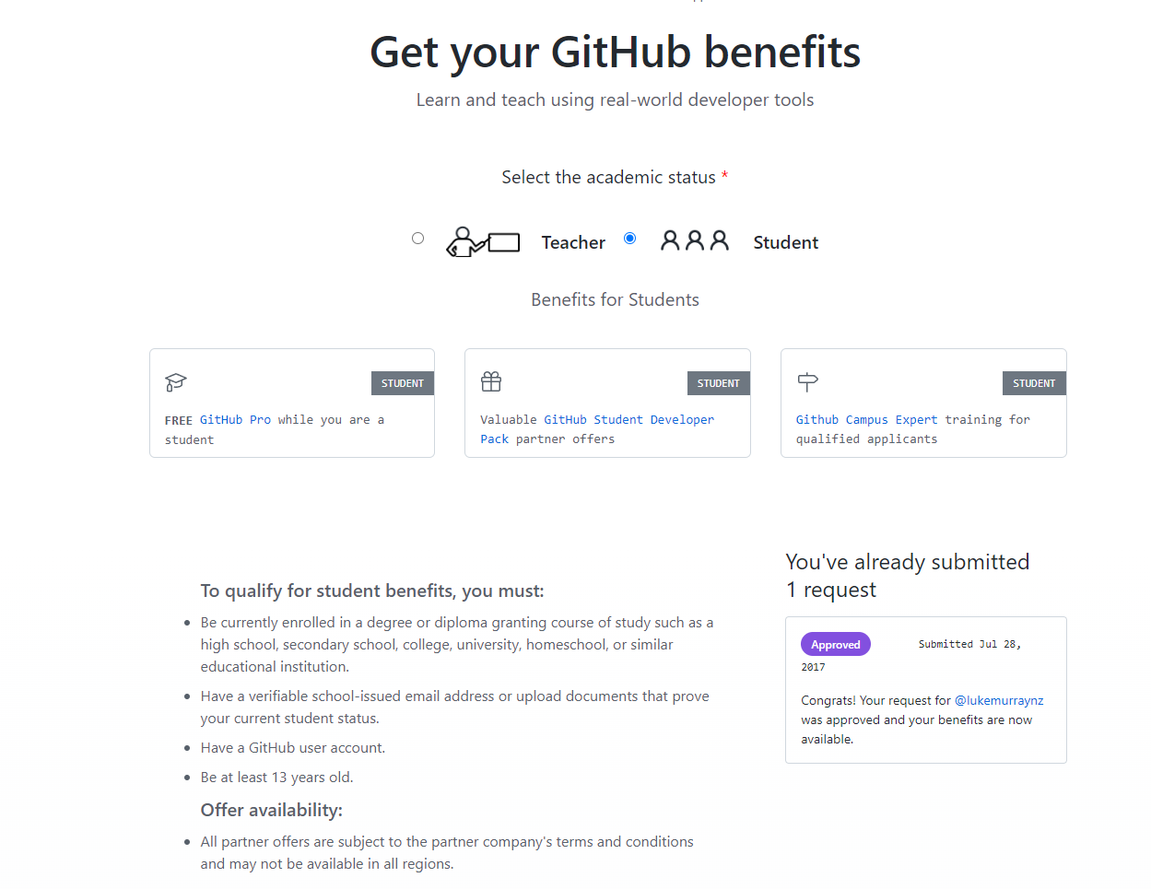
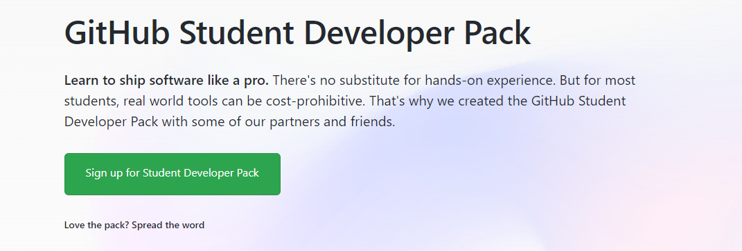
https://education.github.com/benefits?type=student

Slide 22

Awesome Azure Architecture
A curated list of AWESOME blogs, videos, tutorials, code, tools & scripts related to the design and implementation of solutions in Microsoft Azure.
This list contains anything that can help with your Microsoft Azure architecture and quickly get you up and running when designing, planning, and implementing services that empower organisations around the planet to achieve more.
This list can be found at aka.ms/AwesomeAzureArchitecture.

